Slide 1
HTTP PROTOCAL

Slide 2
Server and Port
A server is a computer or device
that provides services, resources, or data to other computers or devices over a network.
A port number is a unique identifier assigned to a specific process or service running on a server.

Slide 3

Node js web server

Slide 4
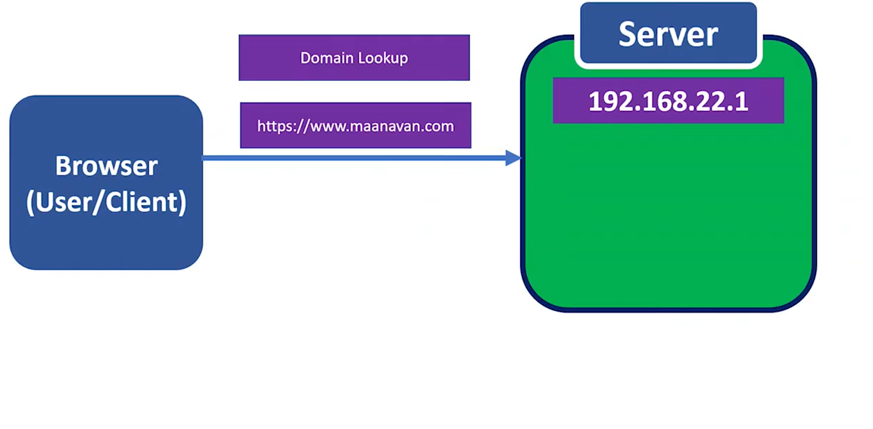
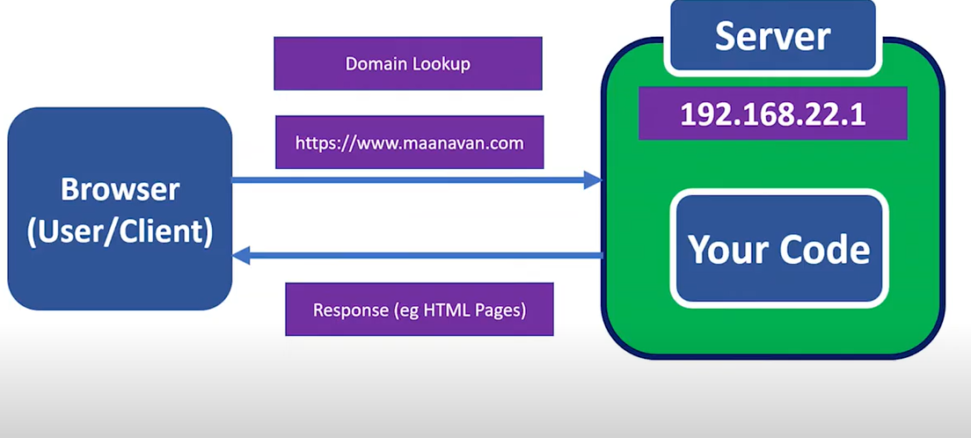
HTTP /HTTPS REQUEST

Slide 5
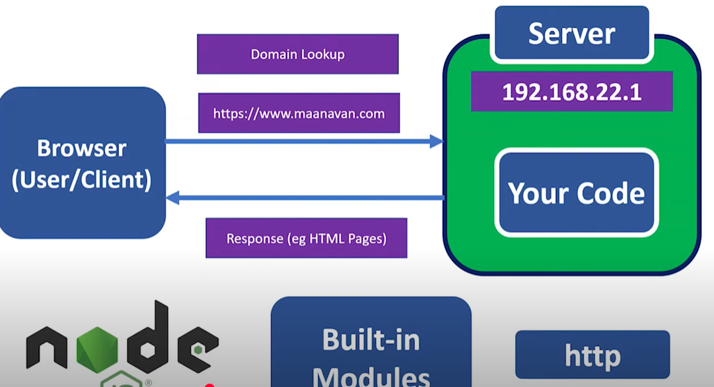
HOW TO CREATE WEB SERVER IN NODE JS

Slide 6
HTTP -Methods
HTTP (Hypertext Transfer Protocol) is a protocol used for transferring data over the internet.
It is a request-response protocol, where a client (such as a web browser) sends a request to a server, and the server responds with the requested data.
1. GET : Retrieves data from a server.
2. POST : Sends data to a server for processing.
3. PUT : Updates existing data on a server.
4. patch :
4. DELETE : Deletes data from a server.

Slide 7
HTTP - Get method
Used to retrieve data from a server.
Request body: None
Response: Data retrieved from the server
Example: GET http://localhost:8080/users

Slide 8
HTTP - Post method
Used to send data to a server for processing.
Request body: Data to be processed
Response: Result of processing the data
Example: POST http://localhost:8080/users

Slide 9
HTTP - PUT
Used to update existing data on a server.
Request body: Updated data
Response: Result of updating the data
Example: PUT http://localhost:8080/proudct/users/1

Slide 10
HTTP - DELETE
Used to delete data from a server.
Request body: None
Response: Result of deleting the data
Example: PUT http://localhost:8080/proudct/users/1

Slide 11
HTTP - PATCH
Used to partially update existing data on a server
Request body: Partially updated data
Response: Result of updating the data
Example: PATCH http://localhost:8080/proudct/users/1

Slide 12
HTTP SERVER CODES
200 (Success/OK)
301 (Permanent Redirect)
302 (Temporary Redirect)
400 (Bad Request)
401 (Unauthorized Error)
403 (Forbidden)
404 (Not Found)
500 (Internal Server Error)
501 (Not Implemented)

Slide 13
HTTP / HTTPS RESPONSE

